Slide 1
Neural Networks
Keith Burghardt, Kristina Lerman
USC Information Sciences Institute
DSCI 552 – Spring 2021

Slide 2
Topics this week
Reviewing Quiz 4
General Artificial Neural Networks and How They “Learn”
Basic Units, Perceptron, Multiple-Layers
Back Propagation Algorithm (minimizing the errors)
Modeling the Brain (very ambitious)
Deep Learning Neural Networks
Improving generalizability
Applications: example in Jupyter notebook

Slide 3
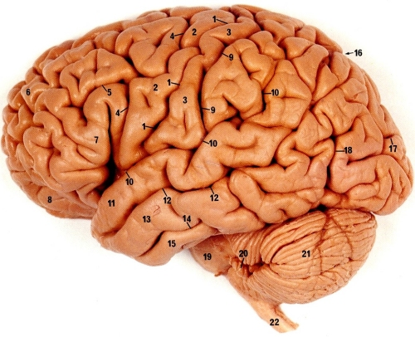
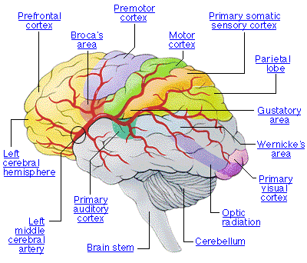
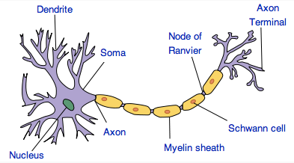
Neural Networks in Brain
Human brain is divided into regions with some functional specialization
E.g., Wernicke’s and Broca’s areas for language
Computation is driven by very large networks of rather slow neurons connected via synapses
10¹¹ neurons of > 20 types
10¹⁴ synapses
1-10ms cycle time
Signals are noisy spike trains of electrical potential
In AI/ML, models of neurons are highly simplified
New Discovery: Glial Cells in Brain boost learning

Slide 4
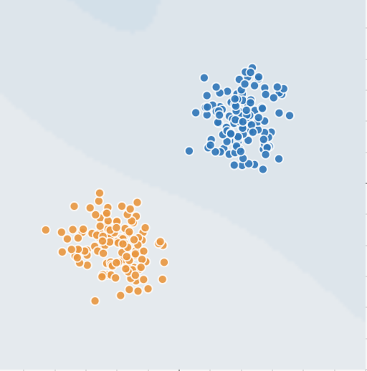
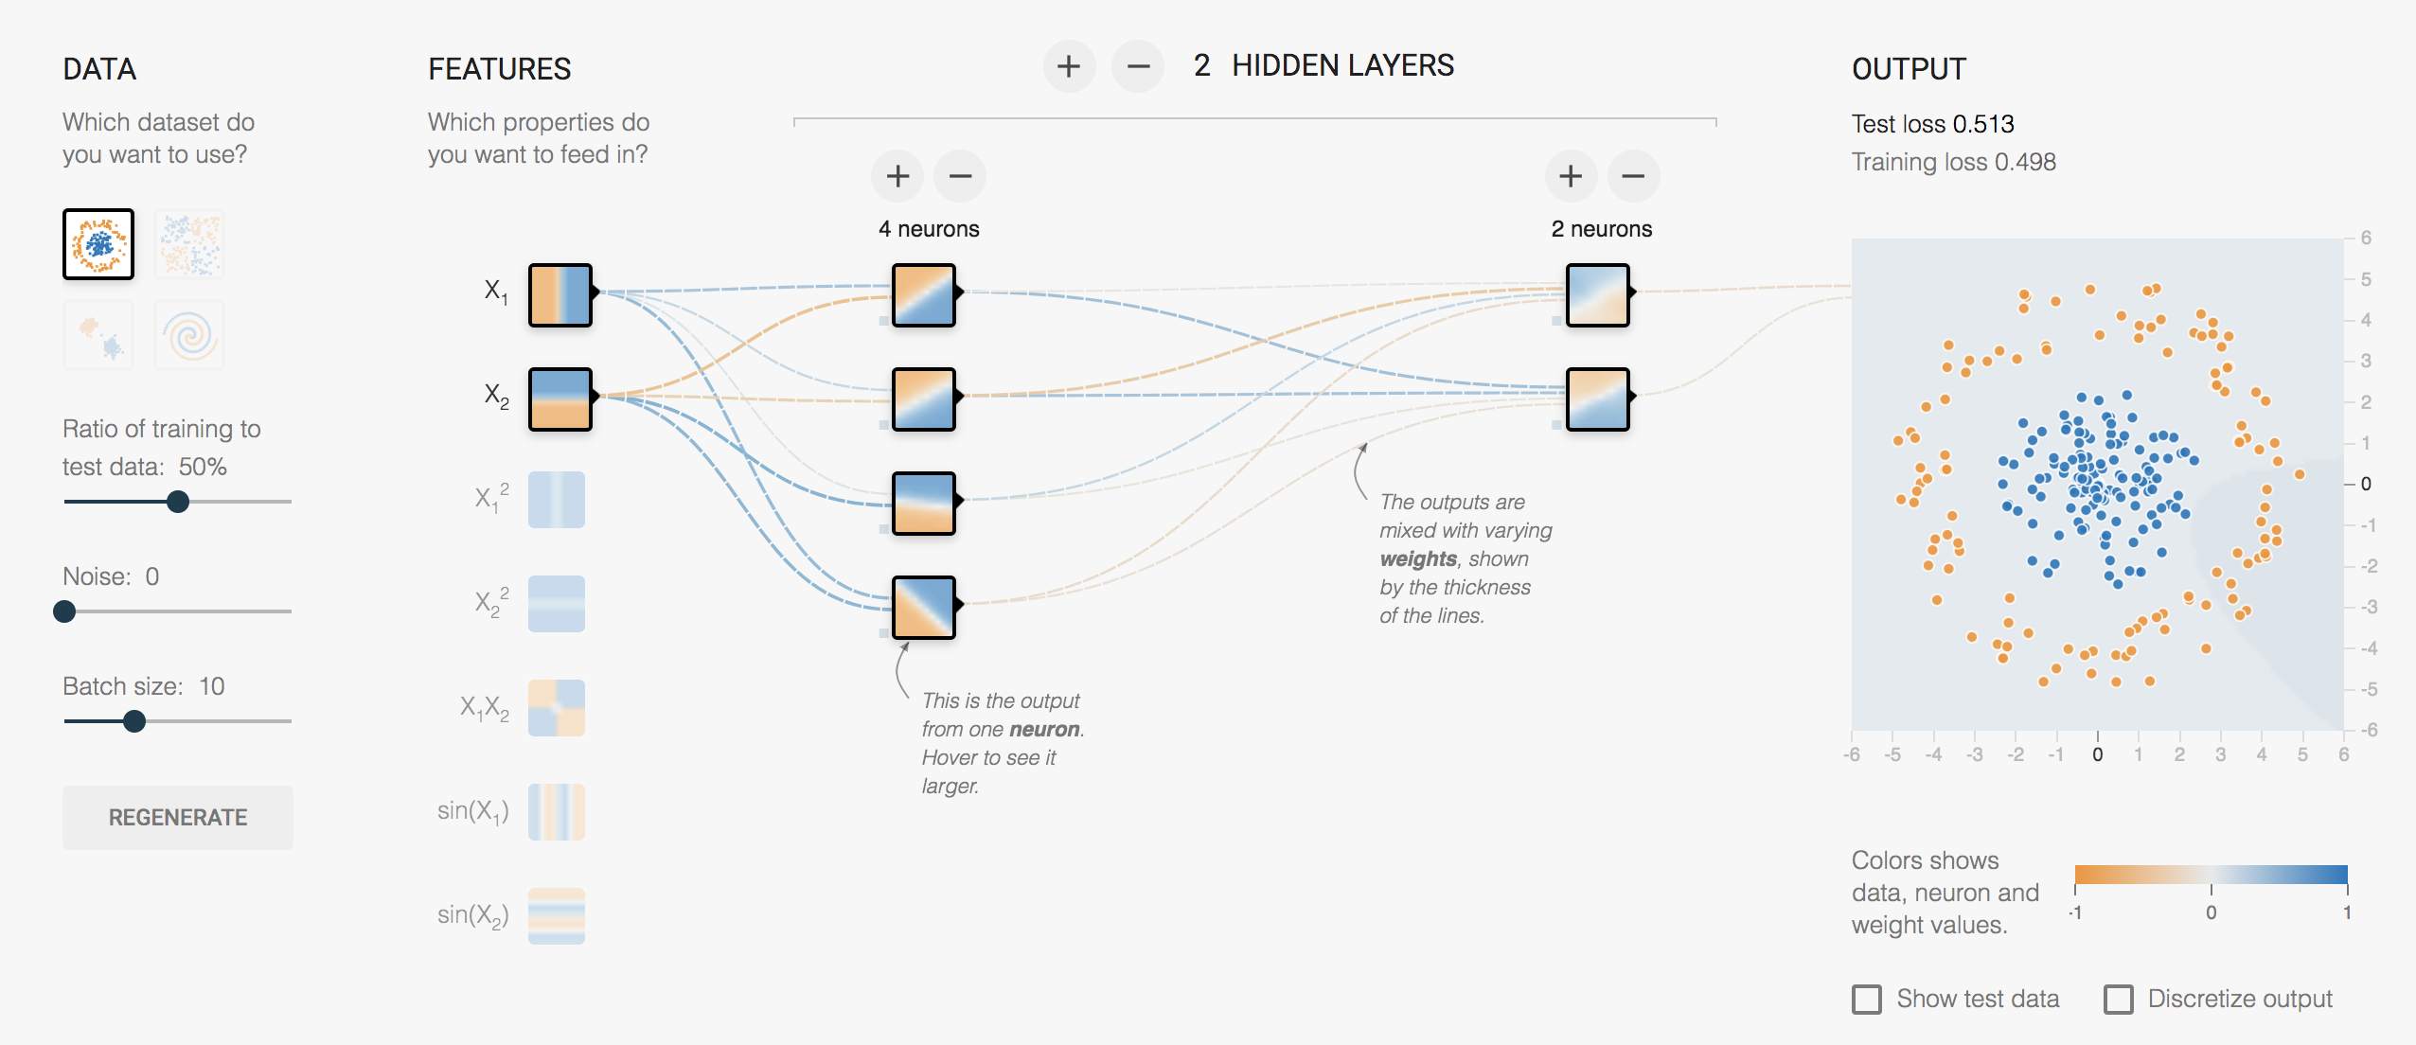
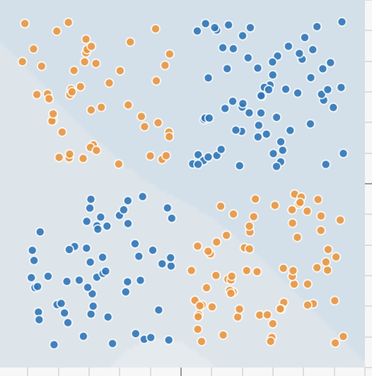

Google’s Neural Network Playground
https://www.playground.tensorflow.org/

Slide 5

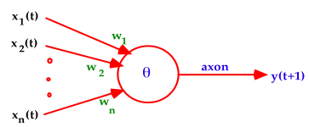
Warren McCulloch and Walter Pitts (1943)
A McCulloch-Pitts neuron operates on a discrete time-scale, t = 0,1,2,3, ... with time tick equal to one refractory period
At each time step, an input or output is
on or off — 1 or 0, respectively.
Each connection or synapse from the output of one neuron to the input of another, has an attached weight.

Slide 6
From Logical Neurons to Finite Automata
X₁
1
Brains, Machines, and
Mathematics, 2nd ed, 1987
AND
1.5
X₂
1
Boolean Net
X₁
1
→
Y
X Y
OR
0.5
1
X₂
NOT
X
X
0
Y
Finite
-1
Automaton
Y
Q
Hopfield Units

Slide 7
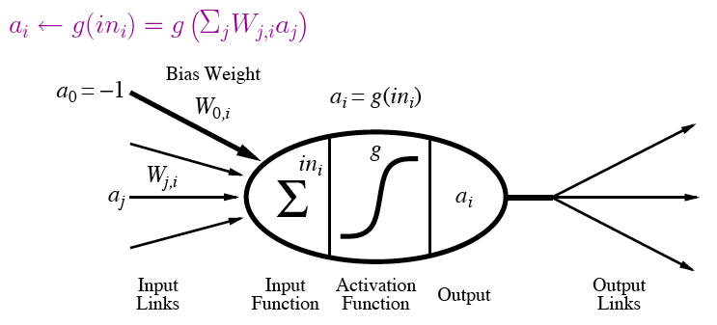
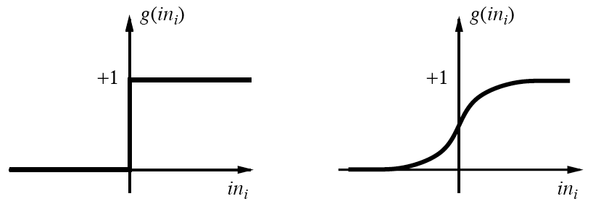
A modern variation of “Units”
Output is a “squashed” linear function of inputs:
Activation function can be step/threshold or sigmoid
Bias weight sets threshold for linear threshold unit

Slide 8
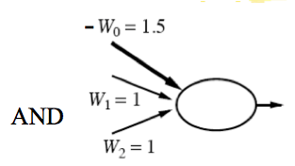
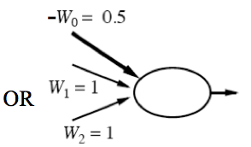
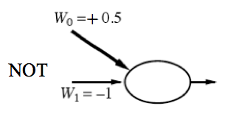
Implementing Logical Functions
Any Boolean function can be implemented in a network of linear threshold units (perceptrons)
But single layer networks are limited
E.g., cannot compute XOR
Minsky & Papert essentially killed off neural network field for a decade by showing this in 1969
Bias weight
Bias weight
Bias weight
Notes:
Ws are weights on inputs, not inputs.
Add all weighted inputs and see if >0

Slide 9
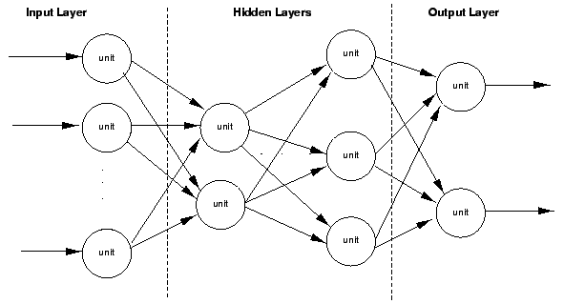
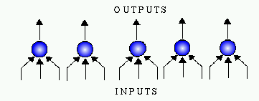
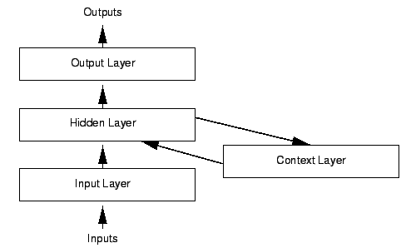
Variety of Network Structures
Feed-forward networks
May be single- or multi-layer
Implement functions/reflexes
No internal state
Recurrent networks
Directed cycles with delays
Internal state, like flip-flops
Dynamical systems
Hopfield networks
LTUs w/ symmetric weights
Minimize overall energy
Boltzmann machines
Stochastic, simulated annealing

Slide 10
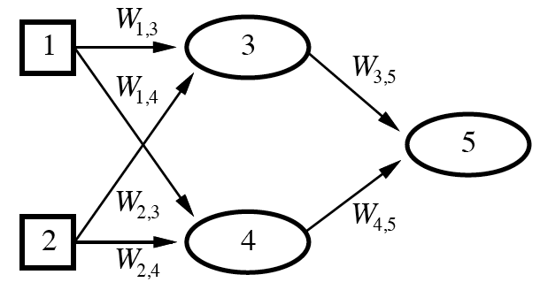
Feed-Forward Example
Feed-forward networks provide a parameterized family of nonlinear functions
a₅ = g(W_{3,5}a₃ + W_{4,5}a₄)
=g(W_{3,5}g(W_{1,3}a₁+W_{2,3}a₂) + W_{4,5}g(W_{1,4}a₁+W_{2,4}a₂))
Learning occurs by adjusting weights

Slide 11
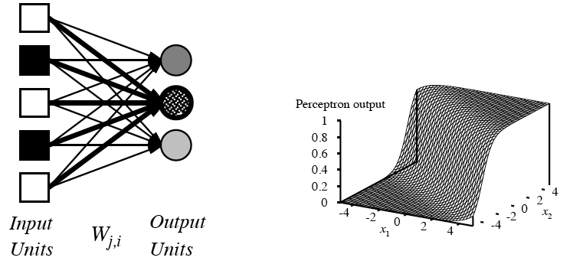
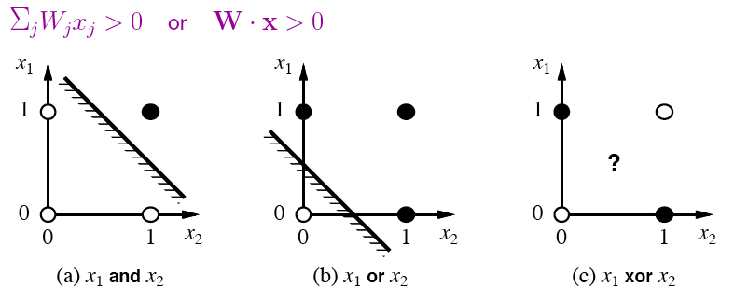
Single-Layer Perceptrons
Each output unit operates separately
Implements a linear separator
Adjusting weights alters location, orientation, and steepness of cliff

Slide 12
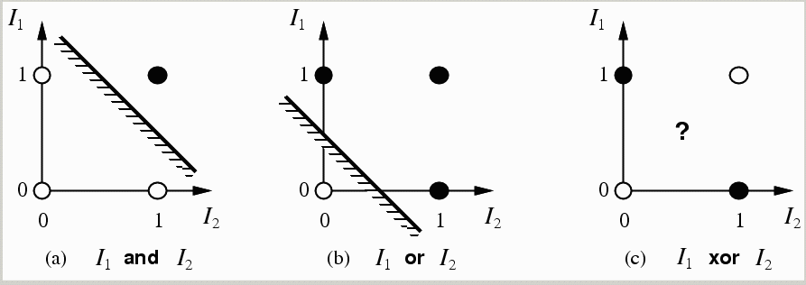
Limitations of a single layer perceptron and linear separability problem
a single layer perceptron can only represent linearly separable functions which follows from the inequalities that determine its firing (Minsky & Papert(1969))
y(t+1) = 1 if and only if Σ w_{i}x_{i}(t) ≥ θ else y(t+1) = 0
i.e. input space is divided in 2

Slide 13
Perceptron Learning
Learn by adjusting weights on each iteration to reduce error
Gradient descent on squared error (y - out)²
Update rule for weights of a threshold function:
W_{j}’ = W_{j} + α(y - out)x_{j}
Comparable rules exist for differentiable activation functions
This perceptron learning rule is guaranteed to converge to a consistent function if the data is linearly separable
x₁
y
W₁
x₂
out
W₂
x₃
W₃
Notes:
y is the correct value on example x
out is the output of the neuron on example x
α is the learning rate
x_{j} is the value of the jth input to x (only modify weight if it actually contributed)
Modify weight according to the degree of error

Slide 14
Majority Function
Output 1 if and only if > ½ of n binary variables are 1
Representable within a perceptron
w_{i} = 1
w₀ = −(n∕2)
o = 1 if and only if a₁+a₂+...+a_{n} − (n∕2) ≥ 0
But a decision tree needs an exponential number of branches
One branch for each combination with a majority of Trues
e.g., IF a₁=1 AND a₂=1 AND… a_{n/2}=1 AND a_{n/2+1}=1 THEN 1
ELSE IF a₁=0 AND a₂=1 AND… a_{n/2+1}=1 AND a_{n/2+2}=1 THEN 1

Slide 15
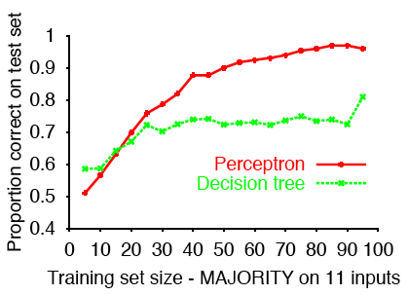
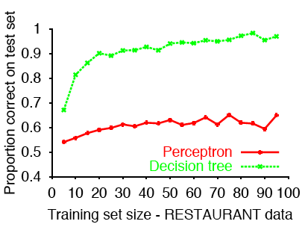
Sample Results
Perceptron learns majority function easily; DTL hopeless
Linearly separable, but difficult to express with yes/no splits on attributes without a path for each combination of attributes that would yield a majority
DTL learns restaurant function easily; single layer perceptron can’t represent it
Data came from a decision tree
Data is not linearly separable
( )
11
6

Slide 16
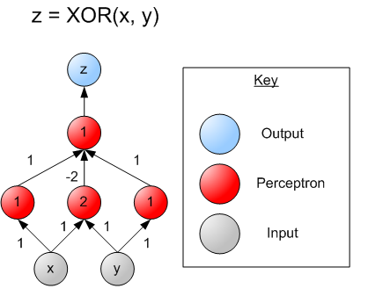
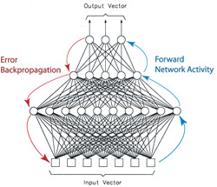
Multi-layer Perceptrons
single layer perceptrons can only represent linear decision surfaces
multi-layer perceptrons can represent non-linear decision surfaces.
16

Slide 17
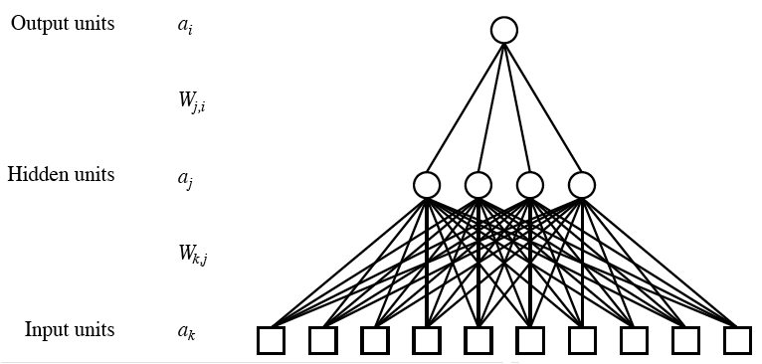
Multilayer Neural Networks
Units typically fully connected across layers unless have domain-specific knowledge to guide
Number of hidden units either chosen by hand or found via search
If too many, network will memorize input (overfitting)
If too few, function will be difficult to represent
As with Goldilocks, need it just right (to generalize)

Slide 18
Back-Propagation (learning) David E Rumelhart, Geoffrey E Hinton, and Ronald J Williams. Learning representations by back-propagating errors. Nature, 323(9) 533-536 1986. www.cs.toronto.edu/hinton/absps/naturebp.pdf.
For anyone interested in how training works
(We will breeze through this)

Slide 19
Learn by Back-Propagation
Challenges for learning in networks with hidden units
Can’t directly compute error on output of hidden units because don’t have the true values for them
Also a clustering problem/opportunity
May yield new useful features
General approach is to (re)apportion error on output units to predecessors based on the weight of their connection, and continue this recursively backwards through the network

Slide 20
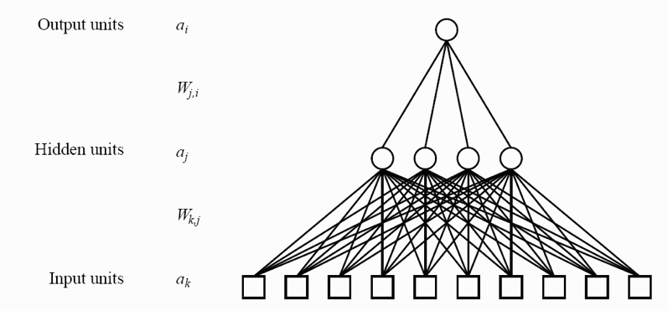
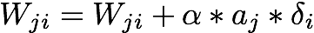
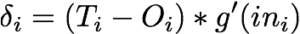
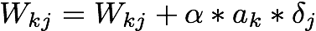
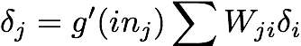
Training a multilayer network using Backpropogation

Slide 21
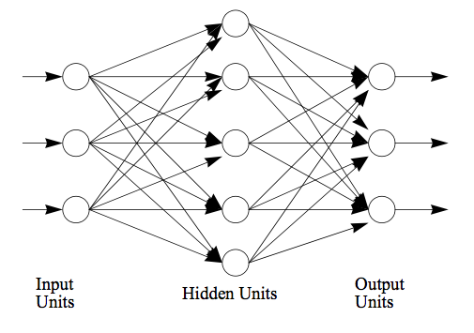
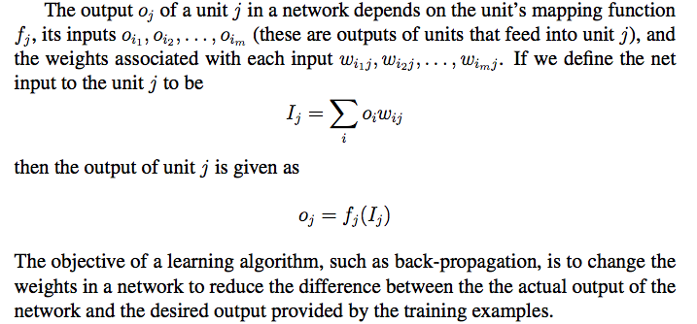
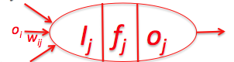
Neural Networks (The back-propagation math) (WS Chapter 4)

Slide 22
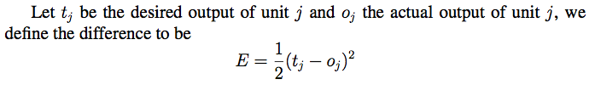
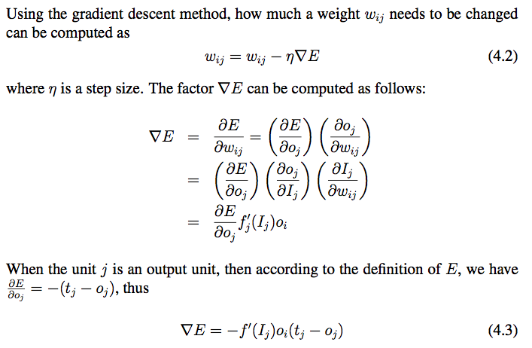
Back-Propagation (1/3)
i
j

Slide 23
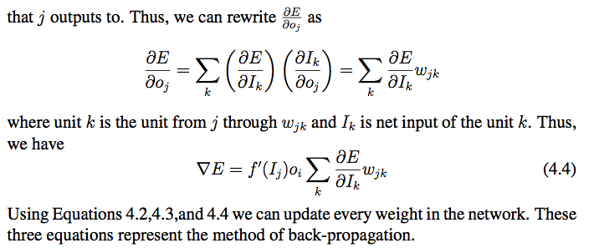
Back-Propagation (2/3)
j
k
i
, where

Slide 24
Back-Propagation (3/3)
Summery: change a link weight from unit i to j using these formulas:
i
j
When j is an output unit
When j is not an output unit
j
k
i

Slide 25
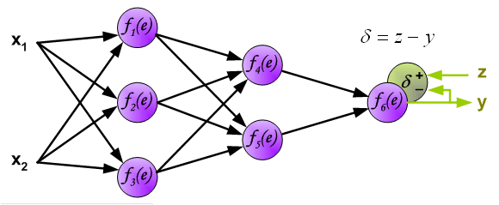
Example of Back-propagation
Note: δ here is equivalent to in the previous slides.

Slide 26
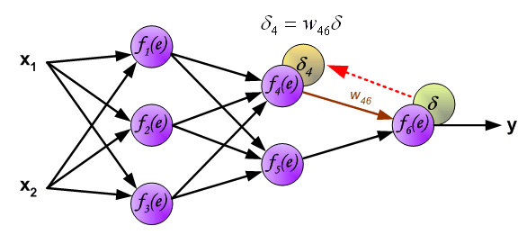
Example of Back-propagation

Slide 27
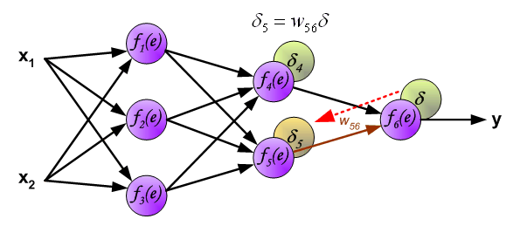
Example of Back-propagation

Slide 28
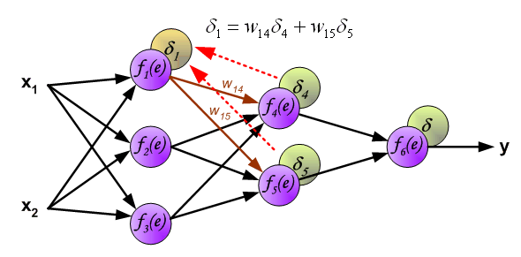
Example of Back-propagation

Slide 29
Some Comments on NNs So Far
Multi-layer networks can overcome the representational limitations of single-layer
Although may have issues with local minima
Recurrent networks are even more powerful, but more complex to understand and work with
Most common applications are in continuous perceptual or perceptuomotor domains
E.g., speech, driving, handwriting, fraud detection
Recently have been efforts to understand relationship between NN and Bayesian learning

Slide 30
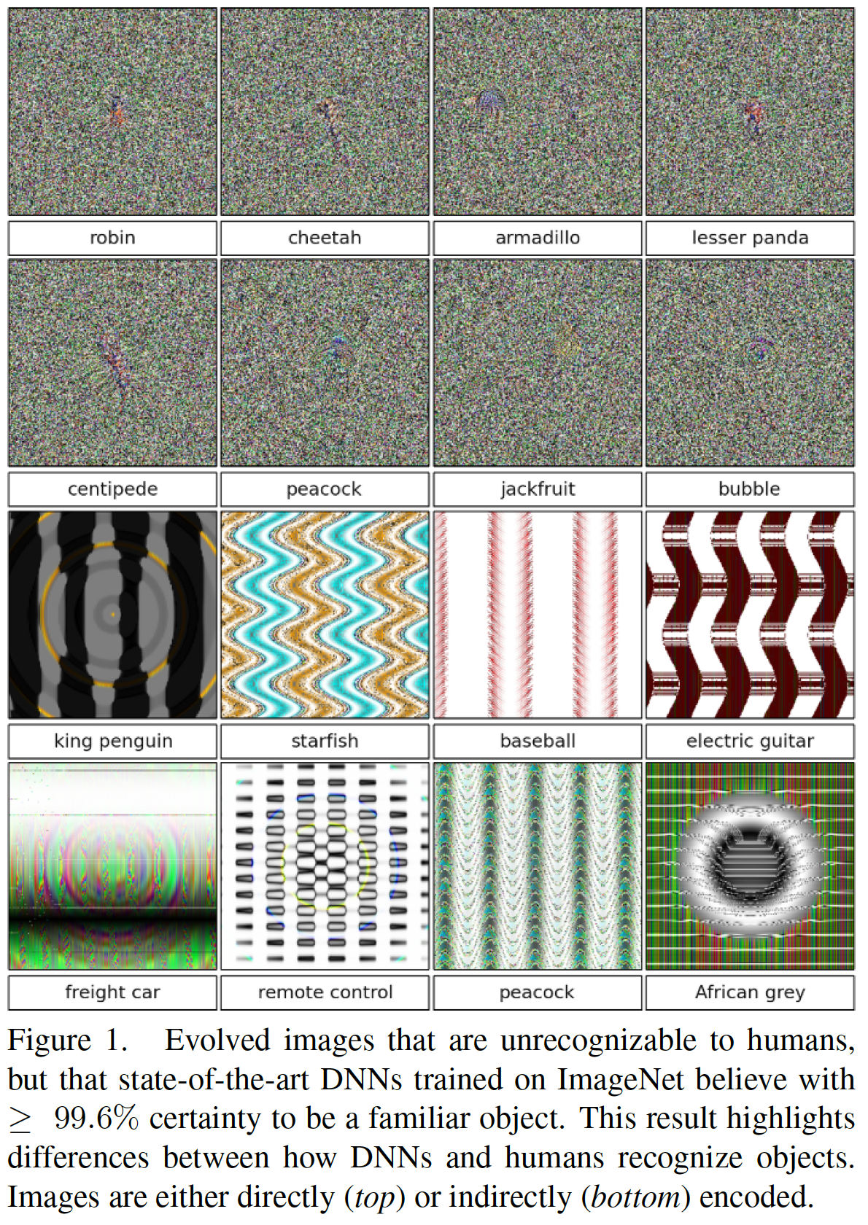
Let’s review some probability theory
You will often hear ”confidence” associated with a neural network output (these are values in the final layer)
This confidence says how far we are from the decision boundary, but does not mean a neural network is “correct”
Nguyen et al., 2015

Slide 31
More examples
Nguyen et al., 2015

Slide 32
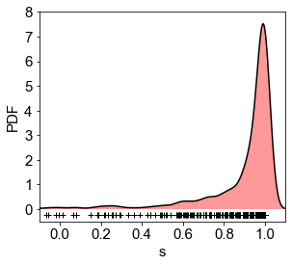
Probability can help you evaluate your models
P(x): probability distribution function
Distribution
randomly chosen
datapoints

Slide 33
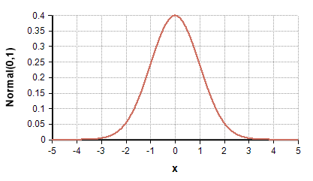
P(x) is NOT a probability!
Integral of P(x) over all of x is 1
But the probability of P(x) for any value of x is infinitesimally small!
Example: Gaussian distribution
The change you will get exactly 1.2132… is essentially 0
The probability you will get between 1.21 and 1.22 is non-zero
Integral of P(x) over an interval is a probability!
Note: for discrete data, e.g., classes, there is no such thing as a probability distribution, ONLY probabilities for each value

Slide 34
Conditional probability distribution
P(x|y): distribution conditional on another feature, y
Conditional probability is defined similarly
Example:
You see a coin from far away
You might expect it’ll be heads or tails with equal probability
You look closer and you see an eagle on the coin
Conditional on seeing an eagle on the coin, you know the probability it is tails-up is 100%
Math:
P(x|y) = P(x,y)/P(y) (by definition)
I.e., the definition tells us the distribution is just P(x,y), for fixed y, normalized so that P(x|y) over all x is 1

Slide 35
Back to Neural Networks
We can discuss the probability of a class (“prior”)
We can also discuss the likelihood of a value for each class (“likelihood”)
We can also discuss the probability of a class given evidence (“posterior”)
Sadly, confidence are none of those things
Especially with little training data, models will give very high confidence to wrong images
“Dunning-Kruger effect” for neural networks
Take model confidence with a grain of salt!

Slide 36
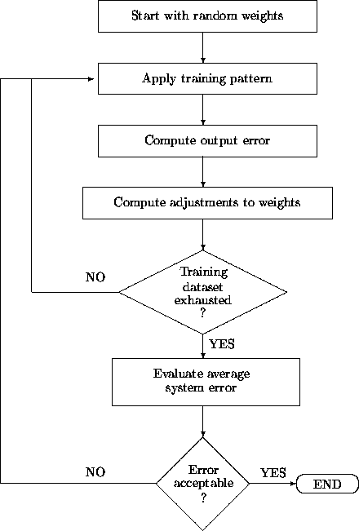
Training a Multilayer Network
Back propogration
prediction

Slide 37
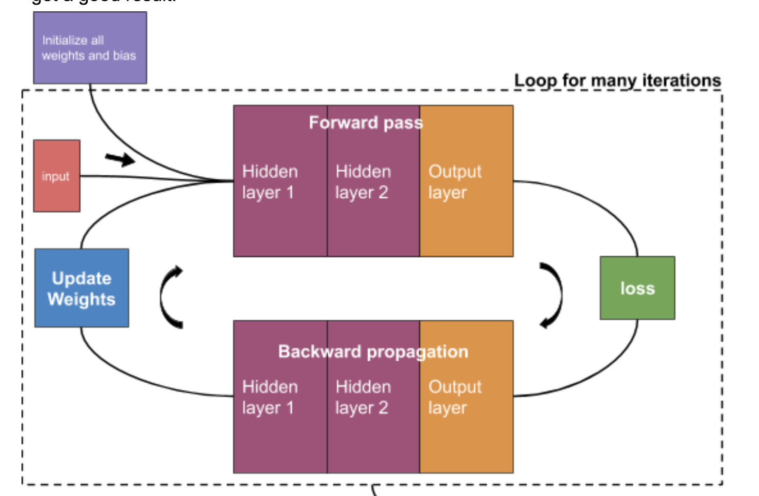

Slide 38
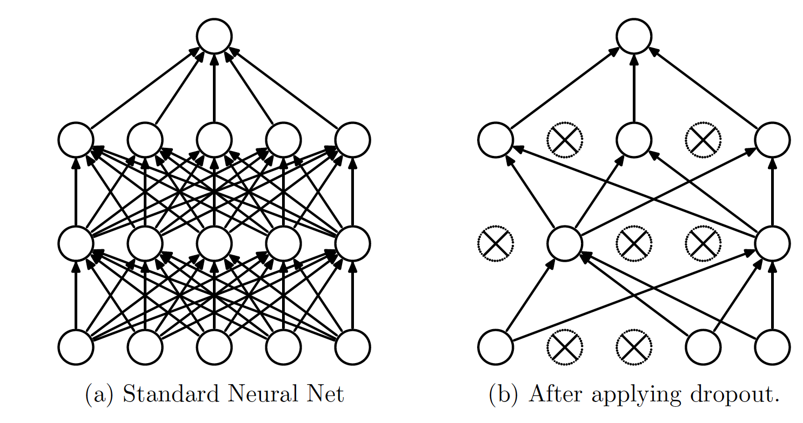
Dropout: A Simple Way to Prevent Neural Networks from Overfitting
Srivastava et al., (2014)

Slide 39
Dropout: The Standard Way to Make NNs Generalize
We want a model to generalize outside of it’s own training data
We previously showed that neural networks benefit from more parameters
But not all parameters are equal!
We want the parameters that best improve model accuracy
Original purpose of dropouts were to better match posterior to confidence
Practically, we use it to improve accuracy without strict regards to matching posteriors
Error quantification with neural networks is still an important field
Bayesian neural networks is one such example

Slide 40
From the paper…
The term ”dropout" refers to dropping out units (hidden and visible) in a neural network.
By dropping a unit out, we mean temporarily removing it from the network, along with all its incoming and outgoing connections, as shown in the previous figure.
The choice of which units to drop is random.
In the simplest case, each unit is retained with a probability p independent of other units, where p can be chosen using a validation set
Or can simply be set at 0.5 [and it often is nowadays], which seems to be close to optimal for a wide range of networks and tasks.
For the input units, however, the optimal probability of retention is usually closer to 1 than to 0.5 [If there is little data, then p<0.5 works well too]

Slide 41
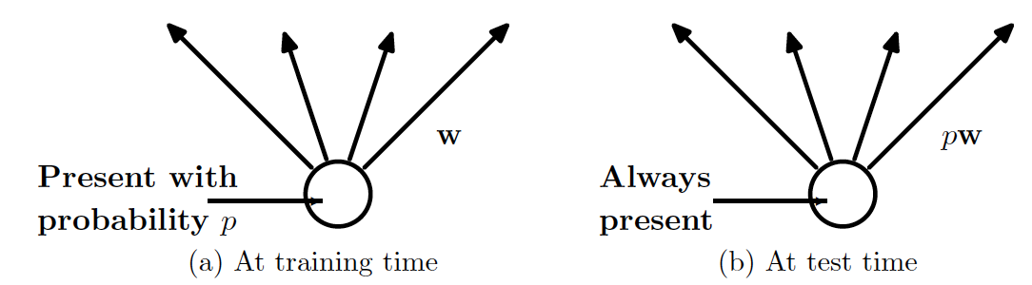
What it does
We rescale weights for each unit by “p”
Weights are now more optimized!

Slide 42
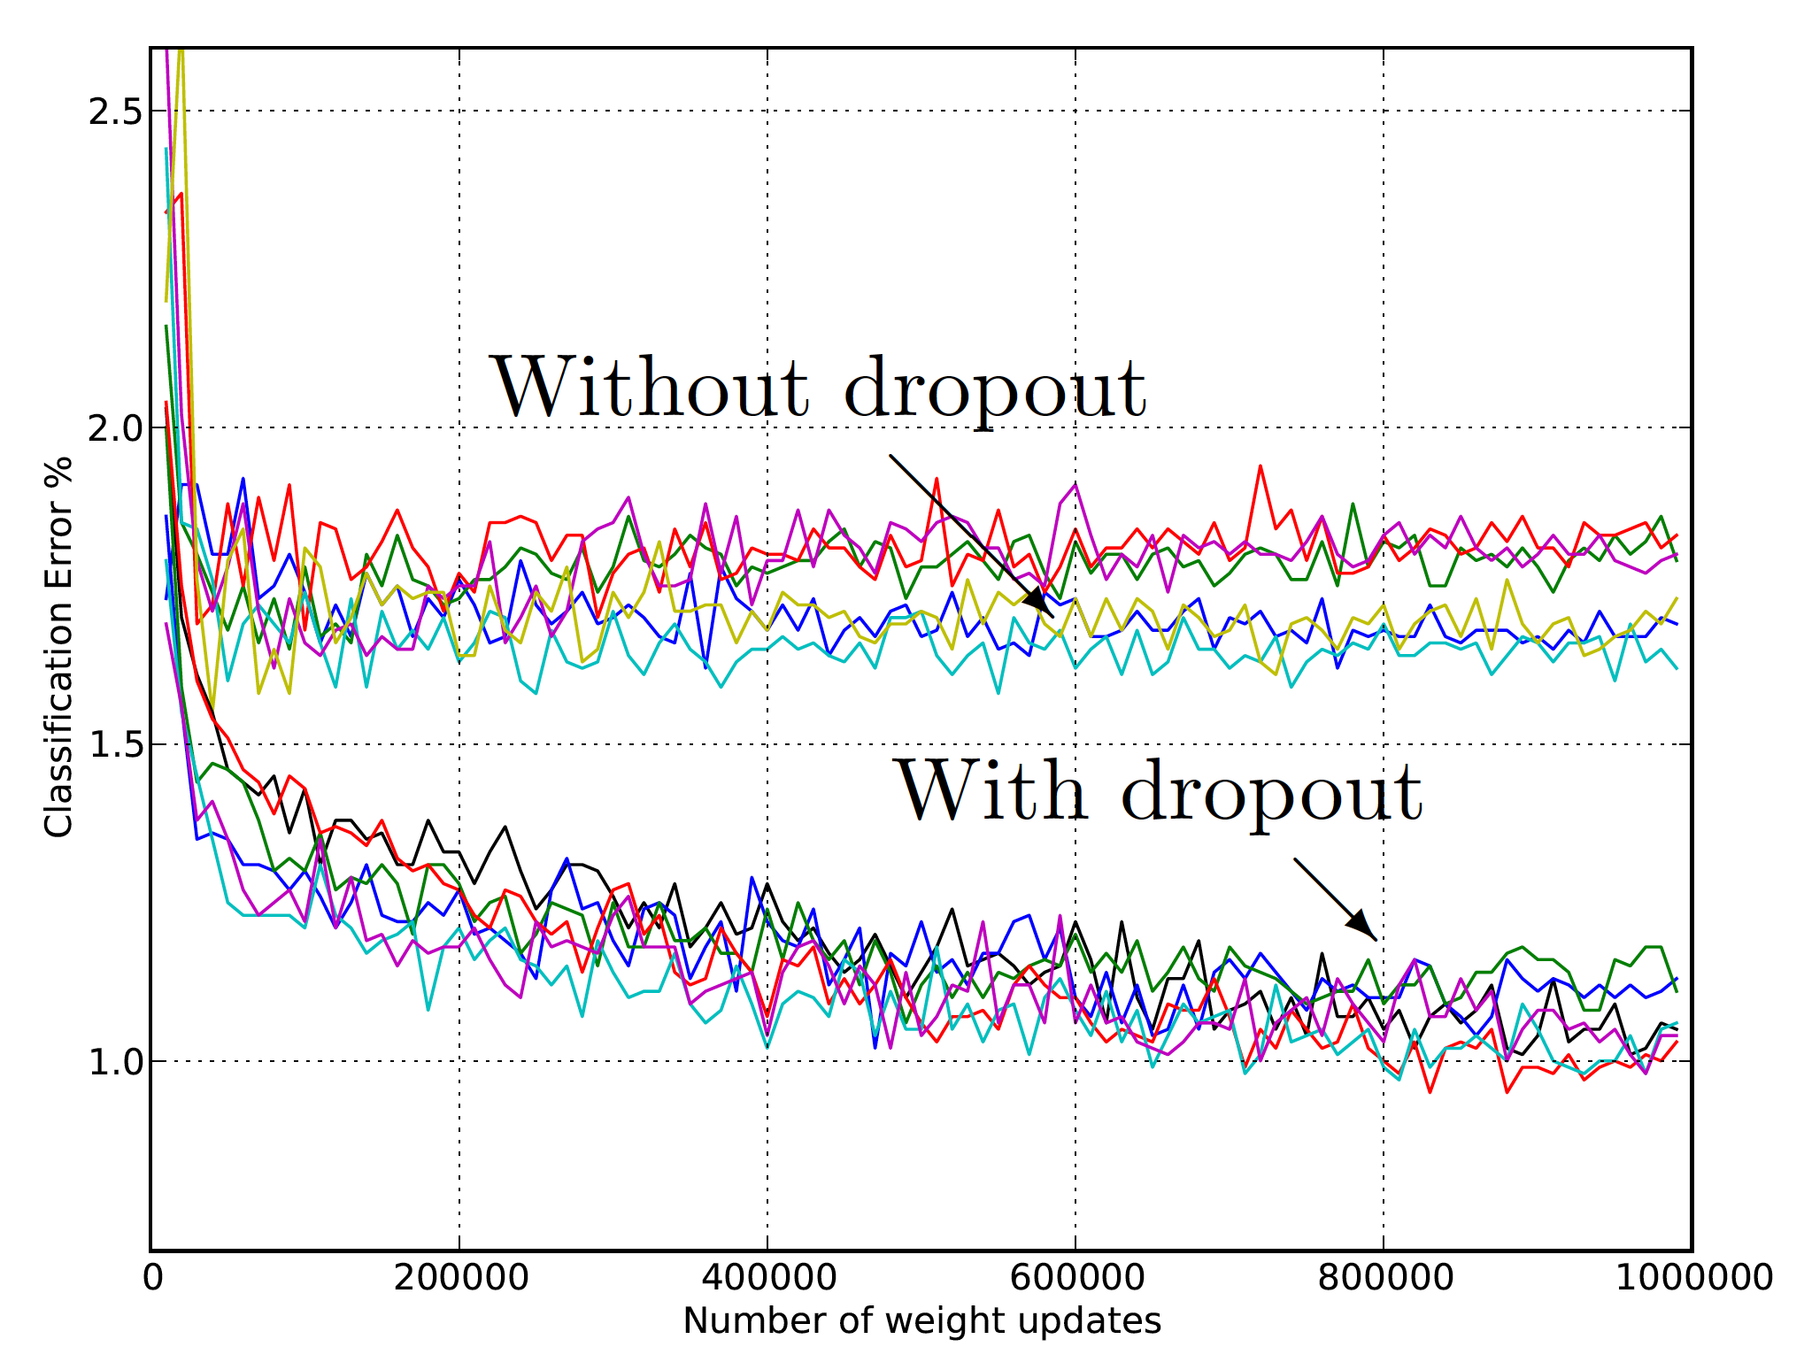
How well it works

Slide 43
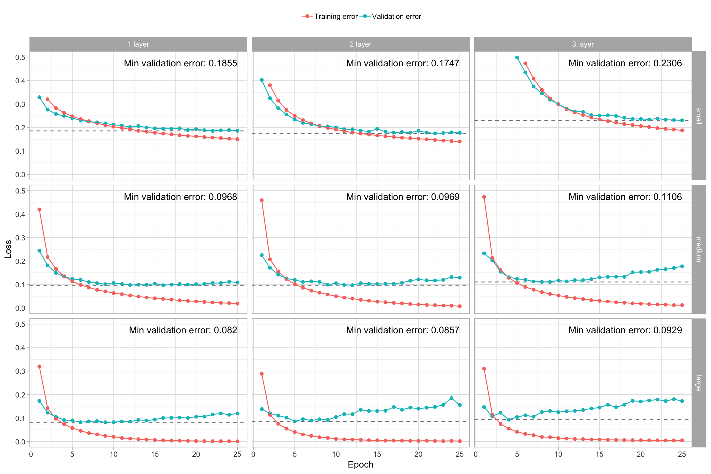
Note: Neural Networks can still overfit!

Slide 44
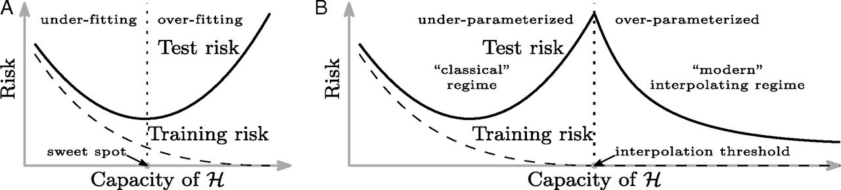
Reducing overfitting
Early stopping: We need to stop a neural network from training too much or error will increase
Similarly, dropout layer is needed to reduce overfitting
Recall we mentioned more parameters = better fit for neural network
How can both findings be true?
Short answer: we do not really know
Long answer: overfitting appears to occur when the model finds global optimum (best parameters for loss), which may not generalize well

Slide 45
Practically fitting networks
Create an architecture
All-to-all connections: “Dense” on Keras
Others we will discuss later:
Convolutional neural network
LSTM
Attention
…
Define a loss function
Split data into training, validation, and testing
Fine-tune (this is most of the work)
Requires knowledge of architectures (which architecture to use in each layer)
“Hyperparameters”: how many nodes in each layer, now many nodes to dropout, …

Slide 46
[Optional] Modeling the Brain

Slide 47
General Comments: Artificial Neural Networks
Artificial Neural Networks provide…
A new computing paradigm
A technique for developing trainable classifiers, memories, dimension-reducing mappings, etc
A tool to study brain functions

Slide 48
Converging Frameworks
Artificial intelligence (AI): build a “packet of intelligence” into a machine
Cognitive psychology: explain human behavior by interacting processes (schemas) “in the head” but not localized in the brain
Brain Theory: interactions of components of the brain -
- computational neuroscience
- neurologically constrained-models
and abstracting from them as both Artificial intelligence and Cognitive psychology:
- connectionism: networks of trainable “quasi-neurons” to provide “parallel distributed models” little constrained by neurophysiology
- abstract (computer program or control system) information processing models

Slide 49
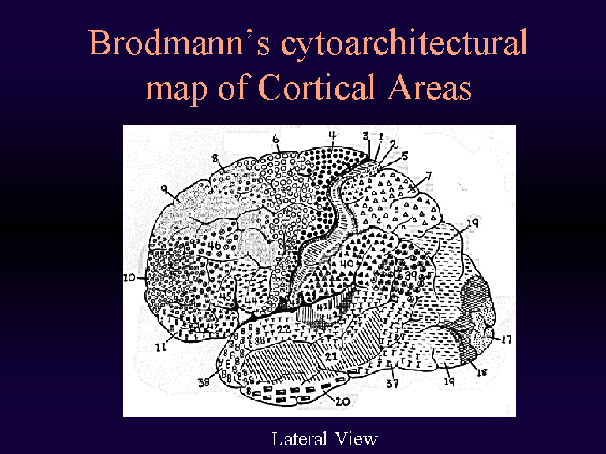
CS 561, Session 20

Slide 50

Major Functional Areas
Primary motor: voluntary movement
Primary somatosensory: tactile, pain, pressure, position, temp., mvt.
Motor association: coordination of complex movements
Sensory association: processing of multisensory information
Prefrontal: planning, emotion, judgement
Speech center (Broca’s area): speech production and articulation
Wernicke’s area: comprehen-
sion of speech
Auditory: hearing
Auditory association: complex
auditory processing
Visual: low-level vision
Visual association: higher-level
vision

Slide 51

Interconnect
Felleman & Van Essen, 1991
CS 561, Session 20

Slide 52

Neurons & synapses
Key terms:
Axon
Dendrites
Synapses
Soma (cell body)

Slide 53

Electron Micrograph of a Real Neuron

Slide 54
Approaches to Neural Modeling
Biologically-realistic, detailed models
E.g., cable equation, multi-compartment models
The Hodgkin-Huxley model
Simulators like NEURON (Yale) or GENESIS (Caltech)
More abstract models, still keeping realism in mind
E.g., integrate & fire model, simple and low detail but preserves spiking behavior
Highly abstract models, neurons as operators
E.g., McCulloch & Pitts model
Classical “neural nets” modeling

Slide 55


Detailed Neural Modeling
A simulator, called “Neuron” has been developed at Yale to simulate the Hodgkin-Huxley equations, as well as other membranes/channels/etc. See http://www.neuron.yale.edu/

Slide 56

The Cable Equation
See http://diwww.epfl.ch/~gerstner/SPNM/SPNM.html
for excellent additional material (some reproduced here).
Just a piece of passive dendrite can yield complicated differential equations which have been extensively studied by electronicians in the context of the study of coaxial cables (TV antenna cable):

Slide 57


The Hodgkin-Huxley Model
Example spike trains obtained…

Slide 58

Leaky Integrator Neuron
The simplest "realistic" neuron model is a continuous time model based on using the firing rate (e.g., the number of spikes traversing the axon in the most recent 20 msec.) as a continuously varying measure of the cell's activity
The state of the neuron is described by a single variable, the membrane potential.
The firing rate is approximated by a sigmoid, function of membrane potential.

Slide 59

The “Basic” Biological Neuron
The soma and dendrites act as the input surface; the axon carries the outputs.
The tips of the branches of the axon form synapses upon other neurons or upon effectors (though synapses may occur along the branches of an axon as well as the ends). The arrows indicate the direction of "typical" information flow from inputs to outputs.

Slide 60

Vision, AI and ANNs
1940s: beginning of Artificial Neural Networks
McCullogh & Pitts, 1942
Σ_{i} w_{i}x_{i} ≥ θ
Perceptron learning rule (Rosenblatt, 1962)
Backpropagation
Hopfield networks (1982)
Kohonen self-organizing maps
…

Slide 61
Excitatory and Inhibitory Synapses
We call a synapse
excitatory if w_{i} > 0, and
inhibitory if w_{i} < 0.
We also associate a threshold θ with each neuron
A neuron fires (i.e., has value 1 on its output line) at time t+1 if the weighted sum of inputs at t reaches or passes θ:
y(t+1) = 1 if and only if Σ w_{i}x_{i}(t) ≥ θ

Slide 62
Increasing the Realism of Neuron Models
The McCulloch-Pitts neuron of 1943 is important
as a basis for
logical analysis of the neurally computable, and
current design of some neural devices (especially when augmented by learning rules to adjust synaptic weights).
However, it is no longer considered a useful model for making contact with neurophysiological data concerning real neurons.

Slide 63


Deep Neural Networks
ImageNet visual recognition challenge:
recognize objects, animals, people, etc
(200 categories) in photographs.
CS 561, Session 20

Slide 64

Deep Neural Networks
Top performers for the 2014 challenge (including winner) are deep neural networks!
CS 561, Session 20

Slide 65

Deep Neural Networks
Very deep layered network (27 layers) with hundreds of millions of parameters.
Trained on very large datasets at Google.

Slide 66
Deep Learning
Multilayer neural networks are one form
Train each layer as if it were a standalone neural network
A hierarchy of loosely connected learning systems
Basic principles are the same as what you’ve learned
But with newer methods for dealing with larger data sets
Finding representations and structures similar to the brain’s
e.g., for facial recognition
And exploiting steady increases in computing power

Slide 67

Scene Understanding

Slide 68
Deep Learning
Train each layer as if it were standalone
Train a neural network to identify the road
Train a neural network to identify a car
Train a neural network to identify a truck
…
A hierarchy of loosely connected learning systems
Train a neural network to identify a clear / busy / unsafe road

Slide 69
Applications: Jupyter Notebook

